Slide 1
Partnership of mature Sons with the Father
Lessons from the Songs of Solomon
27/01/19

Slide 2
Luke 1:13-17
¹⁷He will also go before Him in the spirit and power of Elijah, ‘to turn the hearts of the fathers to the children,’ and the disobedient to the wisdom of the just, to make ready a people prepared for the Lord.
Respond to the love of the Father
Respond to your spiritual parents
Respond to your parents
- Live in a continual revelation of who God is
- Jesus is preparing a Bride for Himself
(His Church)

Slide 3
Our Father in heaven
Rom 8:15 - For you did not receive the spirit of bondage again to fear, but you received the Spirit of adoption by whom we cry out, “Abba, Father.”
Matt 7:11 - If you then, being evil, know how to give good gifts to your children, how much more will your Father who is in heaven give good things to those who ask Him!
Matt 6:9-13 – “Our Father in heaven…”

Slide 4
The bride (Church) and Bridegroom King
Eph 5:25-27 - Husbands, love your wives, just as Christ also loved the church and gave Himself for her, ²⁶ that He might sanctify and cleanse her with the washing of water by the word, ²⁷ that He might present her to Himself a glorious church, not having spot or wrinkle or any such thing, but that she should be holy and without blemish.

Slide 5

The bride (Church) and Bridegroom King
1) Loved the Church and gave Himself

Slide 6
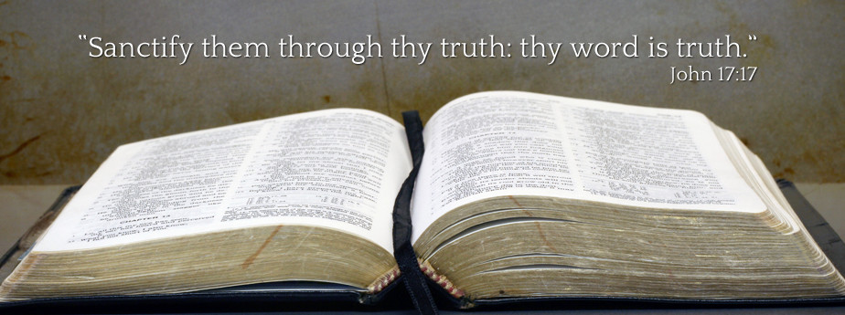
The bride (Church) and Bridegroom King
Loved the Church and gave Himself
Sanctify and cleanse the Church

Slide 7
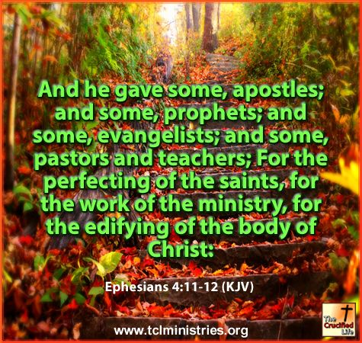
The bride (Church) and Bridegroom King
Loved the Church and gave Himself
Sanctify and cleanse the Church
Preparing the perfect Church

Slide 8

Songs of Solomon 8:6-7
⁶ Set me as a seal upon your heart,
As a seal upon your arm;
For love is as strong as death,
Jealousy as cruel as the grave;
Its flames are flames of fire,
A most vehement flame.
⁷ Many waters cannot quench love,
Nor can the floods drown it.
If a man would give for love all the wealth of his house, It would be utterly despised.

Slide 9

The greatest commandment
Matt 22:37-39 - Jesus said to him, “‘You shall love the Lord your God with all your heart, with all your soul, and with all your mind.’ This is the first and great commandment. And the second is like it: ‘You shall love
your neighbour as yourself.’
John 15:9-10 - “As the Father loved Me, I also have loved you; abide in My love. If you keep My commandments, you will abide in My love, just as I have kept My Father’s commandments and abide in His love.

Slide 10
He sees us as beautiful and precious
SoS 1:5,8,15 - Dark vs lovely, fair/fairest
SoS 4:9 - You have ravished my heart,
My sister, my spouse;
We are lovely before God even in our weakness:
i. God’s personality – He kind and loving
ii. The gift of righteousness – We receive the beauty of Jesus’ righteousness (2 Cor 5:21)
iii. A willing spirit to sincerely obey Him - our victory begins when we decide to obey
iv. Our eternal destiny - He sees our end, the planted seeds of character, our potential and destiny that He has set for us.

Slide 11
1) Develop love-obedience
i) Affection-based obedience
- Flows from experiencing His affection for us.
SoS 7:9 - The wine goes down smoothly for my
beloved.
- I belong to Him so His desire and will is the
most important.
SoS 6:3 - I am my beloved’s & my beloved is mine.
ii) Duty-based obedience
- Obey even when we feel nothing
Fear-based obedience
- Fear of negative consequences

Slide 12
2) Progressive maturity
Challenging the comfort zone
SoS 2:3 - Like an apple tree among the trees of the woods, So is my beloved among the sons. I sat down in his shade with great delight, And his fruit was sweet to my taste.
SoS 2:10 - beloved spoke, and said to me:
“Rise up, my love, my fair one, and come away.
SoS 3:2 - “I will rise now,” I said, And go about the city; In the streets and in the squares, I will seek the one I love.” I sought him, but I did not find him.

Slide 13
2) Progressive maturity
He wants us to grow and experience new things with Him.
Milk vs Meat. 1 Cor 3:2 - I fed you with milk and not with solid food; for until now you were not able to receive it, and even now you are still not able; for you are still carnal.
b) When He disciplines, it is not punishment or condemnation but to release us from what is holding us back.

Slide 14
3) Serving others with and unto the Lord
SoS 6:11 - I went down to the garden of nuts, to see the verdure of the valley, to see whether the vine had budded and the pomegranates had bloomed.
Garden & Vine – Body of Christ, His people
1 Cor 3:9 - For we are God’s fellow workers; you are God’s field, you are God’s building
Budded - ‘immature’ ones budding
Enthusiasm for others flow from knowing His enthusiasm for us when we were immature

Slide 15
3) Serving others with and unto the Lord
SoS 6:12 - Before I was even aware, My soul had made me as the chariots of my noble people.
- Suddenly, in the midst of serving, there is zeal and compassion for God’s people.
- Chariot = move swiftly and powerfully towards the people.
As we put out focus on the Lord, we are continually refreshed and renewed.
Col 3:23 - And whatever you do, do it heartily, as to the Lord and not to men.

Slide 16
3) Serving others with and unto the Lord
SoS 7:11-12
Come, my beloved,
Let us go forth to the field;
Let us lodge in the villages.
Let us get up early to the vineyards;
Let us see if the vine has budded,
Whether the grape blossoms are open,
And the pomegranates are in bloom.
There I will give you my love.

Slide 17
Conclusion
When God’s great love is revealed to us, It is easier to respond in love-obedience.
His desire is not for us to remain where we are but go up higher and higher to where He is (maturity process).
As we mature in Him, we see His heart for others in the family and those outside
Learn to see others as how He sees us.

